Slide 1
Project Team ID: PTID-CDA-AUG-24-200
Project Code:CDACL-003
Team Members:
Darshan N: darshan.1014@gmail.com
Sanjana PR: prsanjana920@gmail.com
Rahul sai Gudiboina : rahulgudiboina@gmail.com

Slide 2
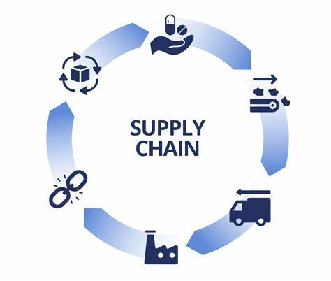
SUPPLY CHAIN ANALYSIS

Slide 3
TOPIC : SUPPLY CHAIN ANALYIS
Attributes Information
1. Product type: The type or category of the product being sold, which could
include classifications such as electronics, clothing, household goods, etc.
2. SKU: Stock Keeping Unit, a unique code assigned to each distinct product or
item for inventory tracking and management.
3. Price: The price of the product, typically in the currency of the country where
the purchase is made (e.g., USD for United States).
4. Availability: Indicates whether the product is currently available for purchase
or out of stock.
5. Number of products sold: The quantity of the product sold in a specific
period, such as daily, monthly, or yearly.
6. Revenue generated: The total amount of revenue generated from selling the
product, calculated by multiplying the price by the number of products sold.
7. Customer demographics: Information about the customers' characteristics and
attributes, such as age, gender, income level, etc.
8. Stock levels: The quantity of the product available in inventory at a given time.
9. Lead times: The time it takes from placing an order until the product is
delivered to the customer.

Slide 4
10.Order quantities: The number of units of the product ordered by customers in each transaction. 11.Shipping times: The time it takes for the product to be shipped from the seller to the customer's location. 12.Shipping carriers: The companies or services responsible for transporting the product from the seller to the customer. 13.Shipping costs: The expenses associated with shipping the product to the customer, including packaging, handling, and transportation fees. 14.Supplier name: The name of the company or entity that supplies the product to the seller.15.Location (Supplier): The geographical location of the supplier's facilities or distribution centers. 16.Manufacturing lead time: The time it takes to manufacture the product from the time the order is placed until it is ready for shipment. 17.Production volumes: The quantity of products produced by the manufacturer within a specific timeframe. 18.Manufacturing costs: The expenses incurred in the process of manufacturing the product, including materials, labor, and overhead costs. 19.Inspection results: The outcomes of quality control inspections performed on the product during or after manufacturing. 20.Defect rates: The percentage of defective or non-conforming products identified during quality control inspections. 21.Transportation modes: The methods or modes of transportation used to move the product between locations, such as air, sea, road, or rail. 22.Routes and costs: The specific routes taken by the product during transportation and associated costs, including fees for tolls, customs, etc.

Slide 5
Profit Analysis
TOPIC : SUPPLY CHAIN ANALYSIS
Analyze the data using Tableau or Power BI and write an analysis report. You can provide your inputs/solution to company.

Slide 6
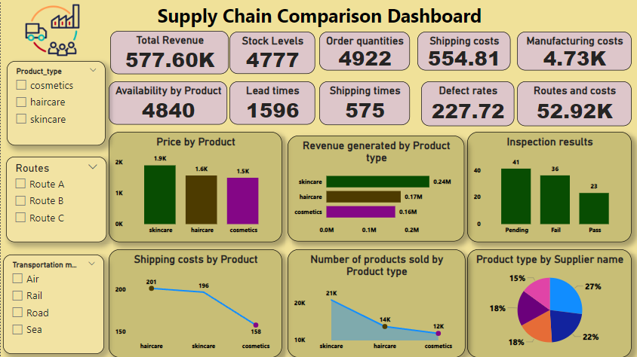

Slide 7
Analysing the Supply Chain Dashboard
OVERVIEW:
This Supply Chain Comparison Dashboard provides an overview of critical supply chain metrics across three product categories cosmetics, haircare, and skincare. The dashboard allows stakeholders to compare performance in key areas such as revenue, costs, stock levels, and product inspection results, offering a clear view of each product type's supply chain efficiency.

Slide 8
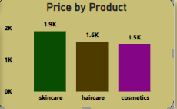
Analyzing prices by products
Key Observations:
The Price by Product chart compares the prices of three different product categories skincare, haircare, and cosmetics. Skincare products are priced the highest at 1.9K, indicated by a green bar, followed by haircare at 1.6K, represented by a brown bar. Cosmetics, shown with a purple bar, have the lowest price at 1.5K. This comparison suggests that skincare products hold a premium position in pricing, while haircare and cosmetics are more moderately priced, with only a slight difference between the two. This pricing strategy could reflect variations in product demand, production costs, or market positioning across these categories.

Slide 9
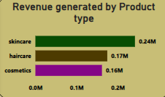
Analyzing revenue generated by product type
Key Observations:
The "Revenue Generated by Product Type" chart shows that skincare products generate the highest revenue at 0.24M, followed by haircare at 0.17M, and cosmetics at 0.16M. This indicates that skincare products contribute the most to overall sales, while haircare and cosmetics have relatively lower but close revenue figures. The chart highlights skincare’s dominant market position in terms of sales performance compared to the other product types.

Slide 10
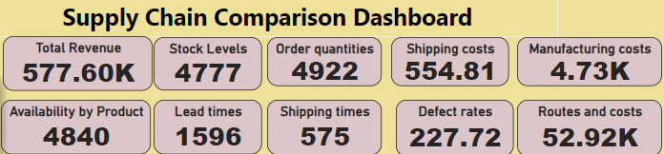
KPIs Information
The KPIs derived from the above attributes help monitor the performance across various stages of the supply chain: from production, inventory management, and quality control, to shipping and customer satisfaction. By tracking these KPIs, businesses can identify bottlenecks, optimize processes, reduce costs, and improve overall supply chain efficiency.

Slide 11
Conclusion:
Overall, the Supply Chain Comparison Dashboard provides valuable insights into product performance, pricing strategies, and operational efficiencies. By leveraging this information, stakeholders can make informed decisions to optimize the supply chain, enhance customer satisfaction, and drive overall business growth. Continuous monitoring and analysis of these metrics will be essential for adapting to market changes and maintaining a competitive edge.

Slide 12
The End

